Slide 1

AWS Data Engineering Virtual Internship
by
K. PUSHPAREKHA
Roll No. 224G1A3273
Department of Computer Science and Engineering (Data Science)
Srinivasa Ramanujan Institute of Technology
(Affiliated to JNTUA & Approved by AICTE) (Accredited by NAAC with ‘A’ Grade & Accredited by NBA (EEE, ECE & CSE)
Rotarypuram Village, B K Samudram Mandal, Ananthapuramu – 515701.
2025 - 2026

Slide 2

Contents
Course Objective
Introduction
Technology
Applications
Modules
Real Time applications
Learning outcomes
GitHub Link
Queries

Slide 3
Course Objective
Understand the fundamentals of AWS Cloud and Data Engineering.
Learn data storage, transformation, and analysis using AWS services.
Design and build data pipelines for real-time analytics.
Gain practical, industry-relevant cloud skills.

Slide 4
Introduction
The internship provided hands-on training on AWS Cloud-based data engineering. It focused on building scalable and secure data pipelines, covering concepts such as ETL, data warehousing, and visualisation. The program helped connect academic knowledge with practical industry experience in the cloud domain.

Slide 5
Technology
AWS S3 – Cloud storage for structured and unstructured data.
AWS Glue – Managed ETL (Extract, Transform, Load) service.
AWS Redshift – Data warehousing and analytical querying.
AWS Lambda – Serverless automation of data workflows.
Amazon Quick Sight – Visualization and reporting tool.

Slide 6
Applications
Data collection and processing from various sources.
Building analytical dashboards using AWS services.
Automating data workflows through serverless architecture.
Enabling business intelligence and decision-making using the cloud.

Slide 7
Real-Time Applications
Real-time data streaming and analytics in industries.
Processing IoT sensor data using AWS pipelines.
Cloud-based financial data analysis and reporting.
Scalable data platforms for e-commerce and healthcare domains.

Slide 8
Learning Outcomes
Developed understanding of cloud-based data workflows.
Gained hands-on experience with AWS tools.
Acquired knowledge in ETL automation and analytics.
Enhanced problem-solving and technical documentation skills.

Slide 9
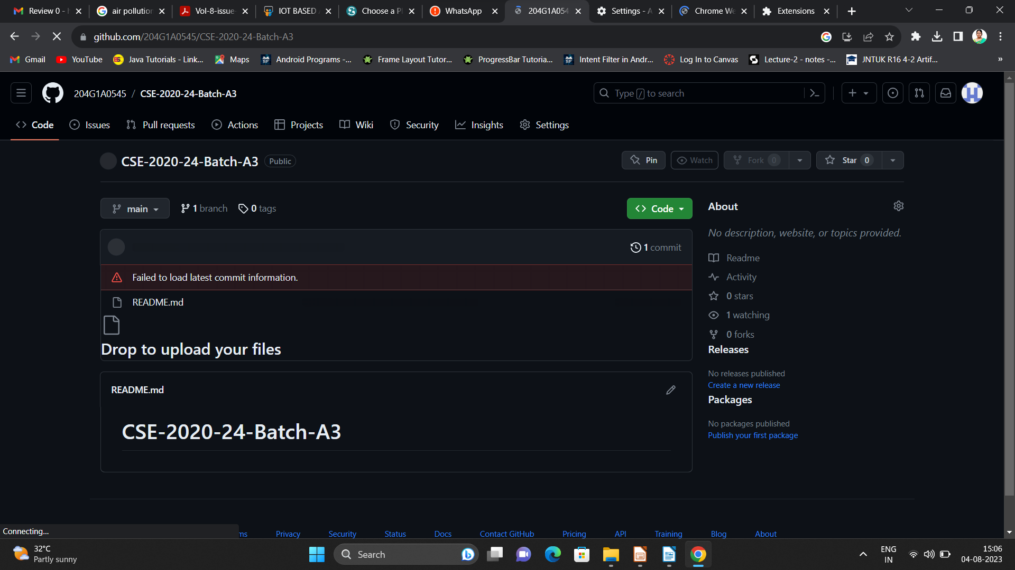

Git Hub Dashboard
Repository Name Like: Summer Internship - I
Under that include document, presentation and Certificate(Pdf).

Slide 10
Any Queries?

Slide 11
Thank You!!!

